Slide 1

Unsupervised website visitor segmentation based on Convolutional Neural Networks and k-means
Project took place within BloomReach
Thesis defense
Notes:
Hello everybody, today I will present to you my Thesis assignment, which went under the name (I know it is long): Unsupervised website visitor segmentation based on Convolutional Neural Networks and k-means
Before proceeding we should mention that the project took place within BloomReach. The company can be labelled as technology provider, who aims at improving the experience of the end online-user and his relationship with the business. To be more specific the research is built around one of BloomReach products — Experience Manager

Slide 2
Agenda
Outline
Project Statement
Related Work
Our Approach
Research Questions
Results
Conclusion
Questions
Notes:
Important to say is that the presentation followed the flow of the final paper.
With this being said the agenda for today is as follows.
First we will start with a short presentation of the context and motivation of this research.
Followed by Problem statement + Research Questions
Which will lead to our approach, our results aka summary of the evaluation section
And we will finish with Conclusion and Future work.
Due to the tight schedule, I would kindly ask you, unless very urgent, to wait with the questions for the Q and A session.

Slide 3
Agenda
Outline
Project Statement
Related Work
Our Approach
Research Questions
Results
Conclusion
Questions

Slide 4
Outline
The digital era has changed a lot of domains, however in this thesis we focus on E-commerce
The E-commerce represents the act of buying or selling goods through the World Wide Web
One of the fastest growing domains: expected to go over three trillion dollars in sales
Notes:
To the context.
Although the digital era has changed a lot of domains, in this paper we focus on e-commerce. E-commerce represents the act of buying or selling goods through the World Wide Web (WWW). An interesting fact for the e-commerce is that it is one of the..
With all this in mind we can conclude that shopping is no longer related to the physical shop, rather going to the web. Bearing all this in mind, we can understand how important it is to make the online experience of the user as pleasant as possible.
https://www.paymill.com/en/blog/18-overlooked-ux-hacks-to-boost-your-ecommerce-sales/

Slide 5
Outline
But how can companies make the most of this fast growing domain?
Notes:
But then you would ask: how do companies make the most of this fast growing domain?

Slide 6
One approach: Visitor Segmentation & Content Management
Notes:
One approach of achieving this is through improving the user experience via Visitor Segmentation and Content Management - which is magically is also the focus of this Thesis
Image credits: https://www.tellius.com/ai-driven-marketing/segmentation-illustration/
AUTHOR
Hardik Chheda

Slide 7
Agenda
Outline
Project Statement
Related Work
Our Approach
Research Questions
Results
Conclusion
Questions
Notes:
The Context being covered, we will move to the second point for today - Problem Statement and Research Questions

Slide 8
Project Statement
Back to user segmentation …
Project is based on CMS – Content Management System
Notes:
Back to the user segmentation and content management ...
The focus of this thesis are Content Management Systems, such as BloomReach Experience.
Most content management platforms, like BloomReach Experience, include the ability to segment site visitors manually; a content manager will create a segment and inform the platform what characteristics of a visitor match what segment.
Simply put our idea is to automate the creation of user segments
Simply put – Automate creation of user segments

Slide 9
Search Phrases: baby clothes
Location: Amsterdam
Segment: Ams - new parent
Number of visits: 5
Notes:
a content manager will create a segment and inform the platform what characteristics of a visitor match what segment.
For example; site visitor location is Amsterdam and they are browsing baby clothes > put into segment ‘Ams- new parent’. It is then possible to adapt a website’s content for that user based on the segment they have been assigned.

Slide 10
Summarized:
Introduce data driven creation of segments
Giving more flexibility and adaptiveness in case of new users
Reduce the role of content managers and manual input for the system
Notes:
To summarize:
Our idea is to introduce data driven creation of segments. One of the advantages of this is that it will give more flexibility and will also reduce the role of the content managers and the manual input for the system

Slide 11
Summarized:
Introduce data driven creation of segments
Notes:
To summarize:
Our idea is to introduce data driven creation of segments. One of the advantages of this is that it will give more flexibility and will also reduce the role of the content managers and the manual input for the system

Slide 12
Two ways of creating user-segments
Traditional
Data-driven
- Based on domain knowledge
+ Based on user’s usage data
- Based on personal expertise
+ Can show unforeseen user behavior
- Difficult to measure
+ More users, aka more transparency
+ Can check scale of impact
+ More precise
Notes:
But if we decide to deep a bit more into the advantages, here we can see two ways of user-segments creation: Traditional and Data-driven

Slide 13
Agenda
Outline
Project Statement
Related Work
Our Approach
Research Questions
Results
Conclusion
Questions

Slide 14
Related Work
In-house research, within BloomReach, Georgios Vletsas et al. [1] – Baseline Model
Automated Visitor Segmentation and Targeting, done via applying K-modes clustering algorithm on keywords extracted from the visited, by the user, URL.
Process Outline:
1. Read file
2. Filter data
3. Sort data frame
4. Identify transactions
5. Extract information from transactions
6. Remove unnecessary data
7. Cluster data
Notes:
This task is not something new and in our case it is based on an in-house research which was done a year ago.
Basically this project and ours have the same end goal, thus it is the same project just different direction/approach
Firstly we were motivate by an in-house research, within the sponsoring company, later on referred to as Baseline Model. The official name was Automated Visitor Segmentation and Targeting

Slide 15
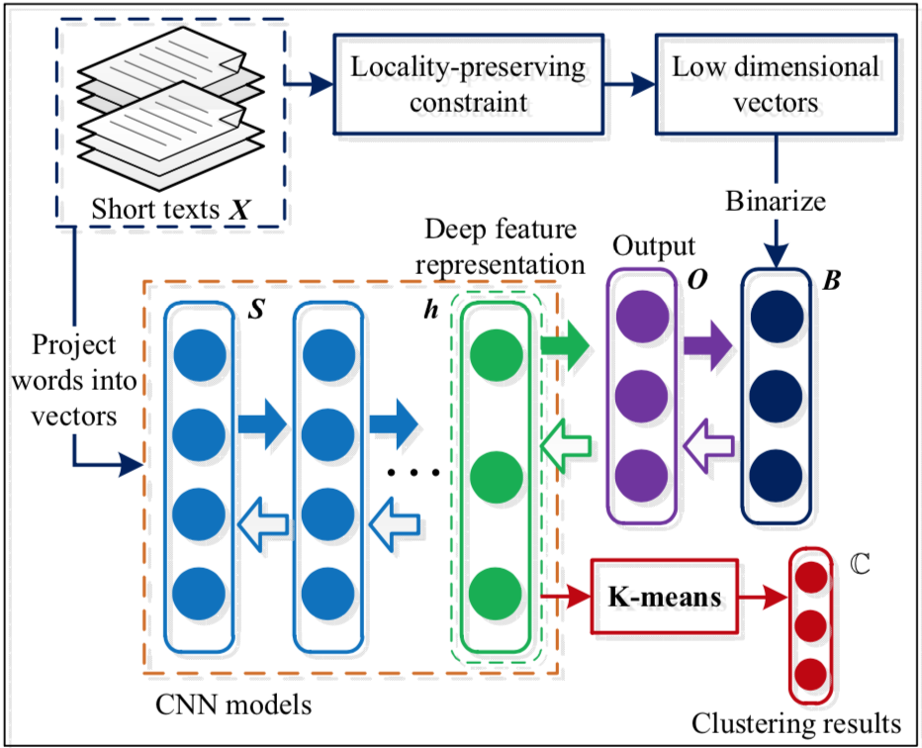
Related Work
Short Text Clustering via Convolutional Neural Networks, Jiaming Xu et al. [2]
Jiaming Xu et al. proposed an approach for training Convolutional Neural Network (CNN) in an unsupervised way using word embeddings.
Notes:
The second motivation has to do with the work of Jiaming Xu et al. - Short Text Clustering via Neural Networks.
The interesting in their work is the way they are training the Neural network - they basically use weighted matrix in combination with average embedding.

Slide 16
Agenda
Outline
Project Statement
Related Work
Our Approach
Research Questions
Results
Conclusion
Questions

Slide 17
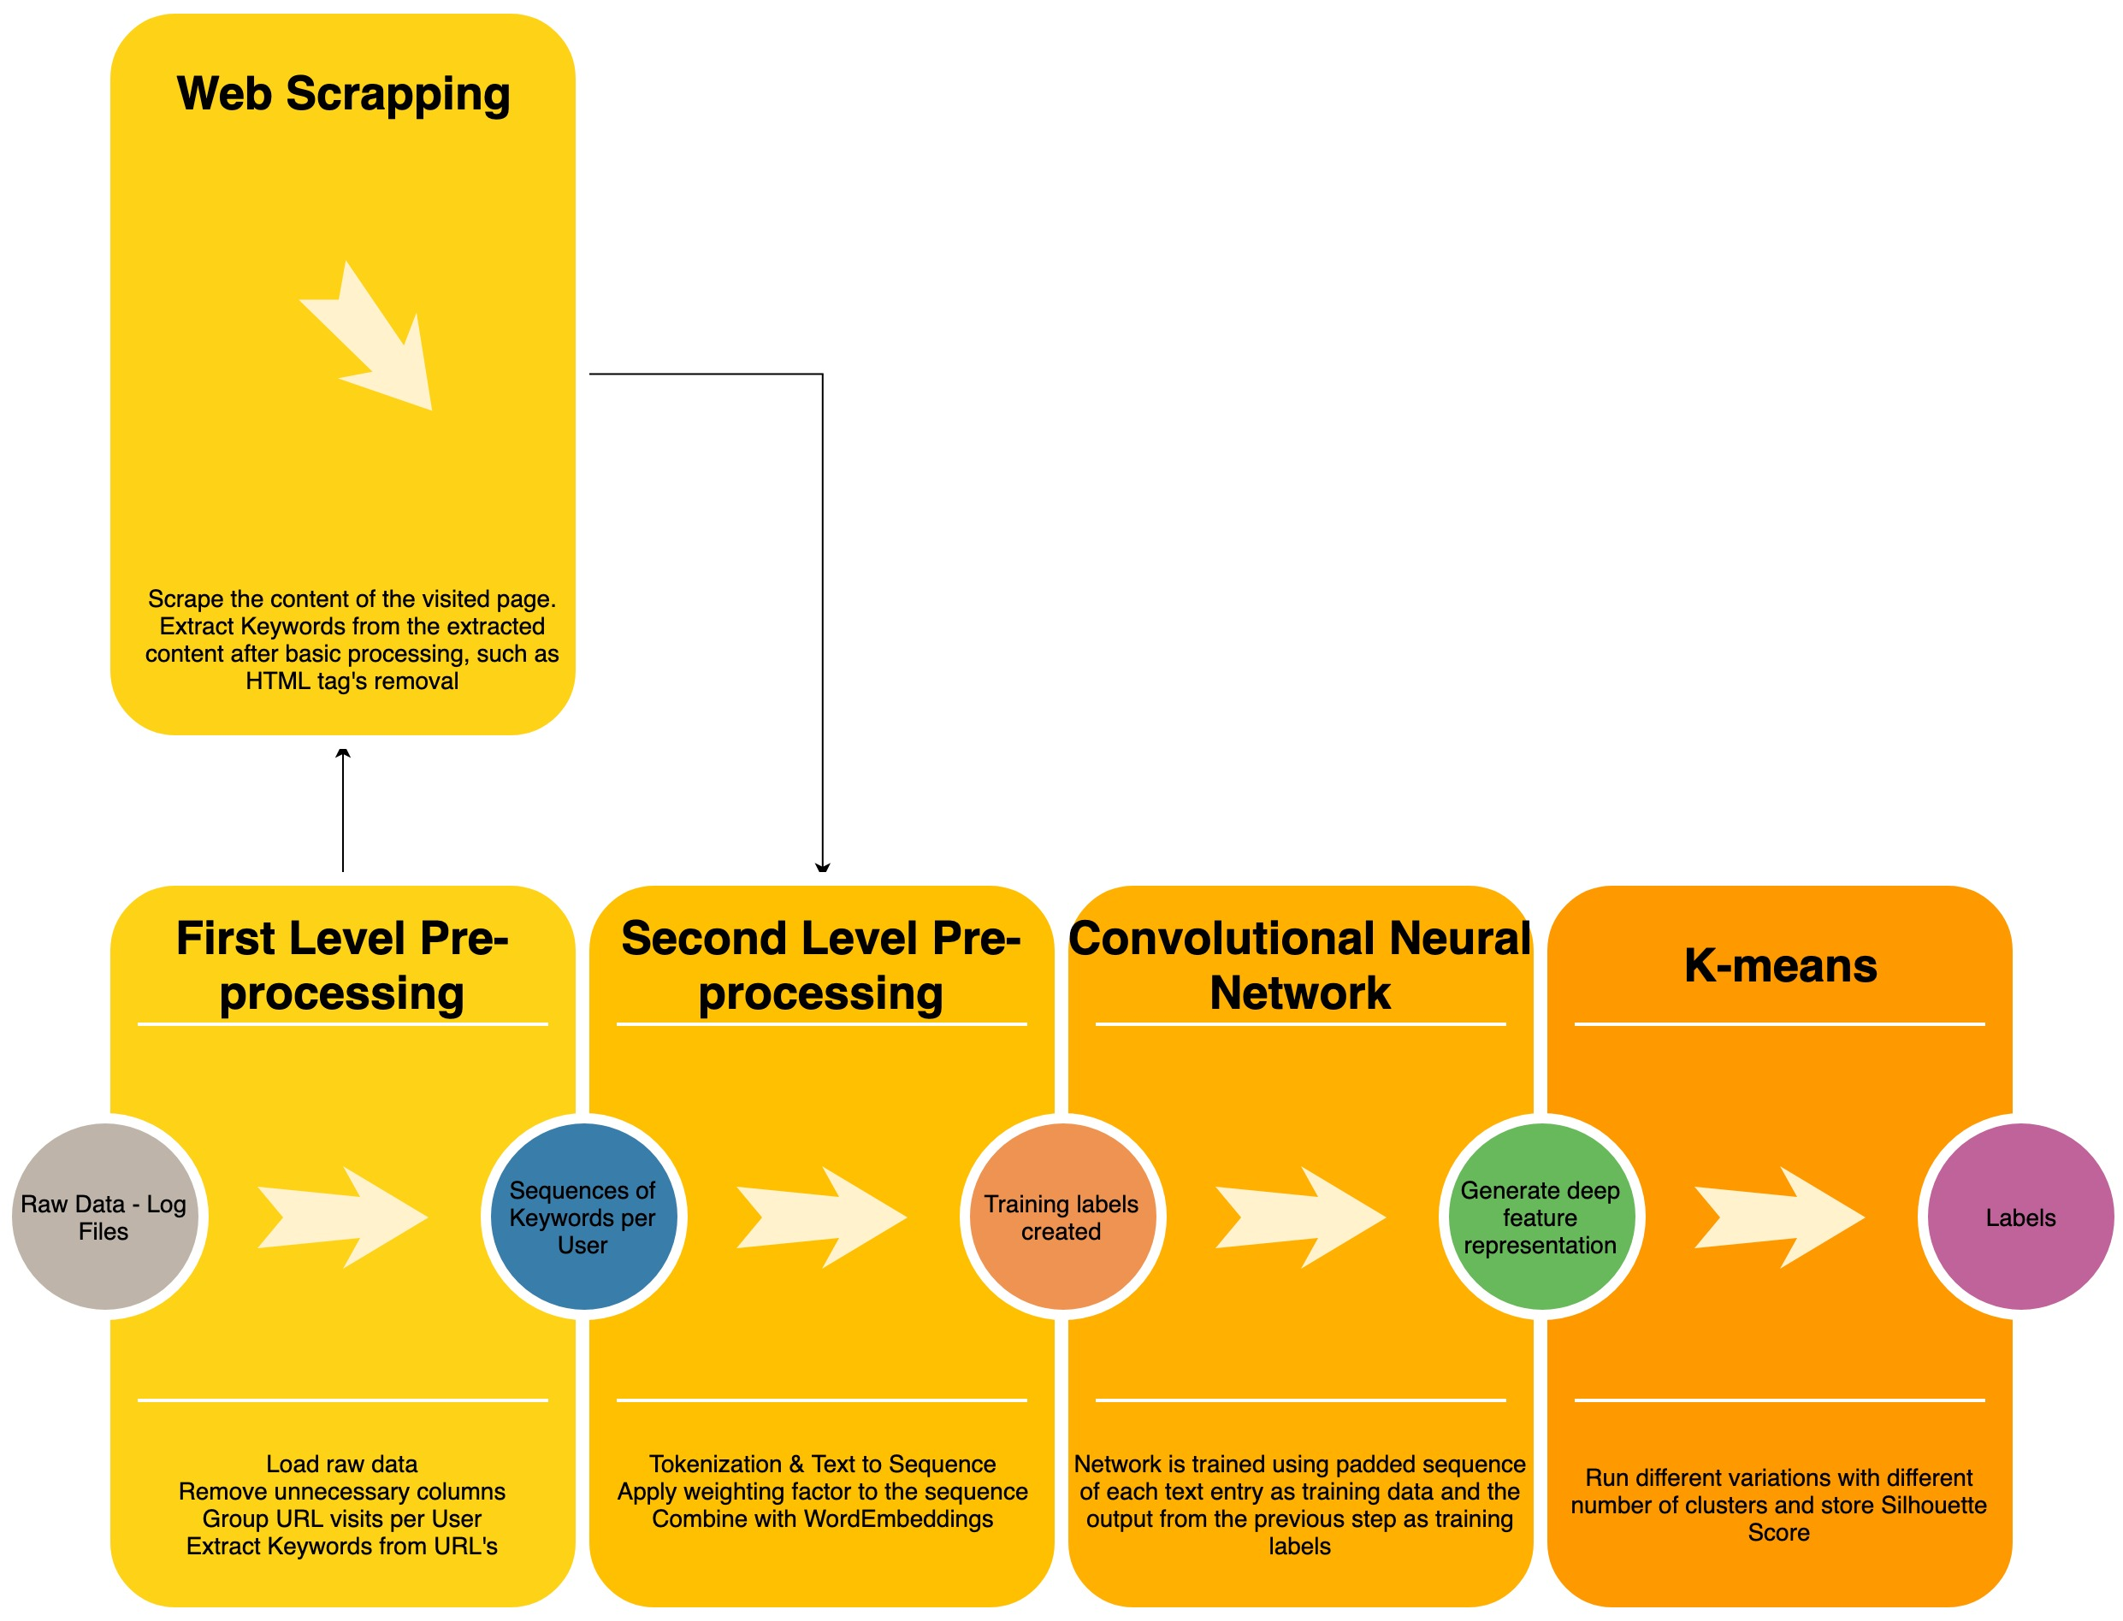
Our Approach High level

Slide 18
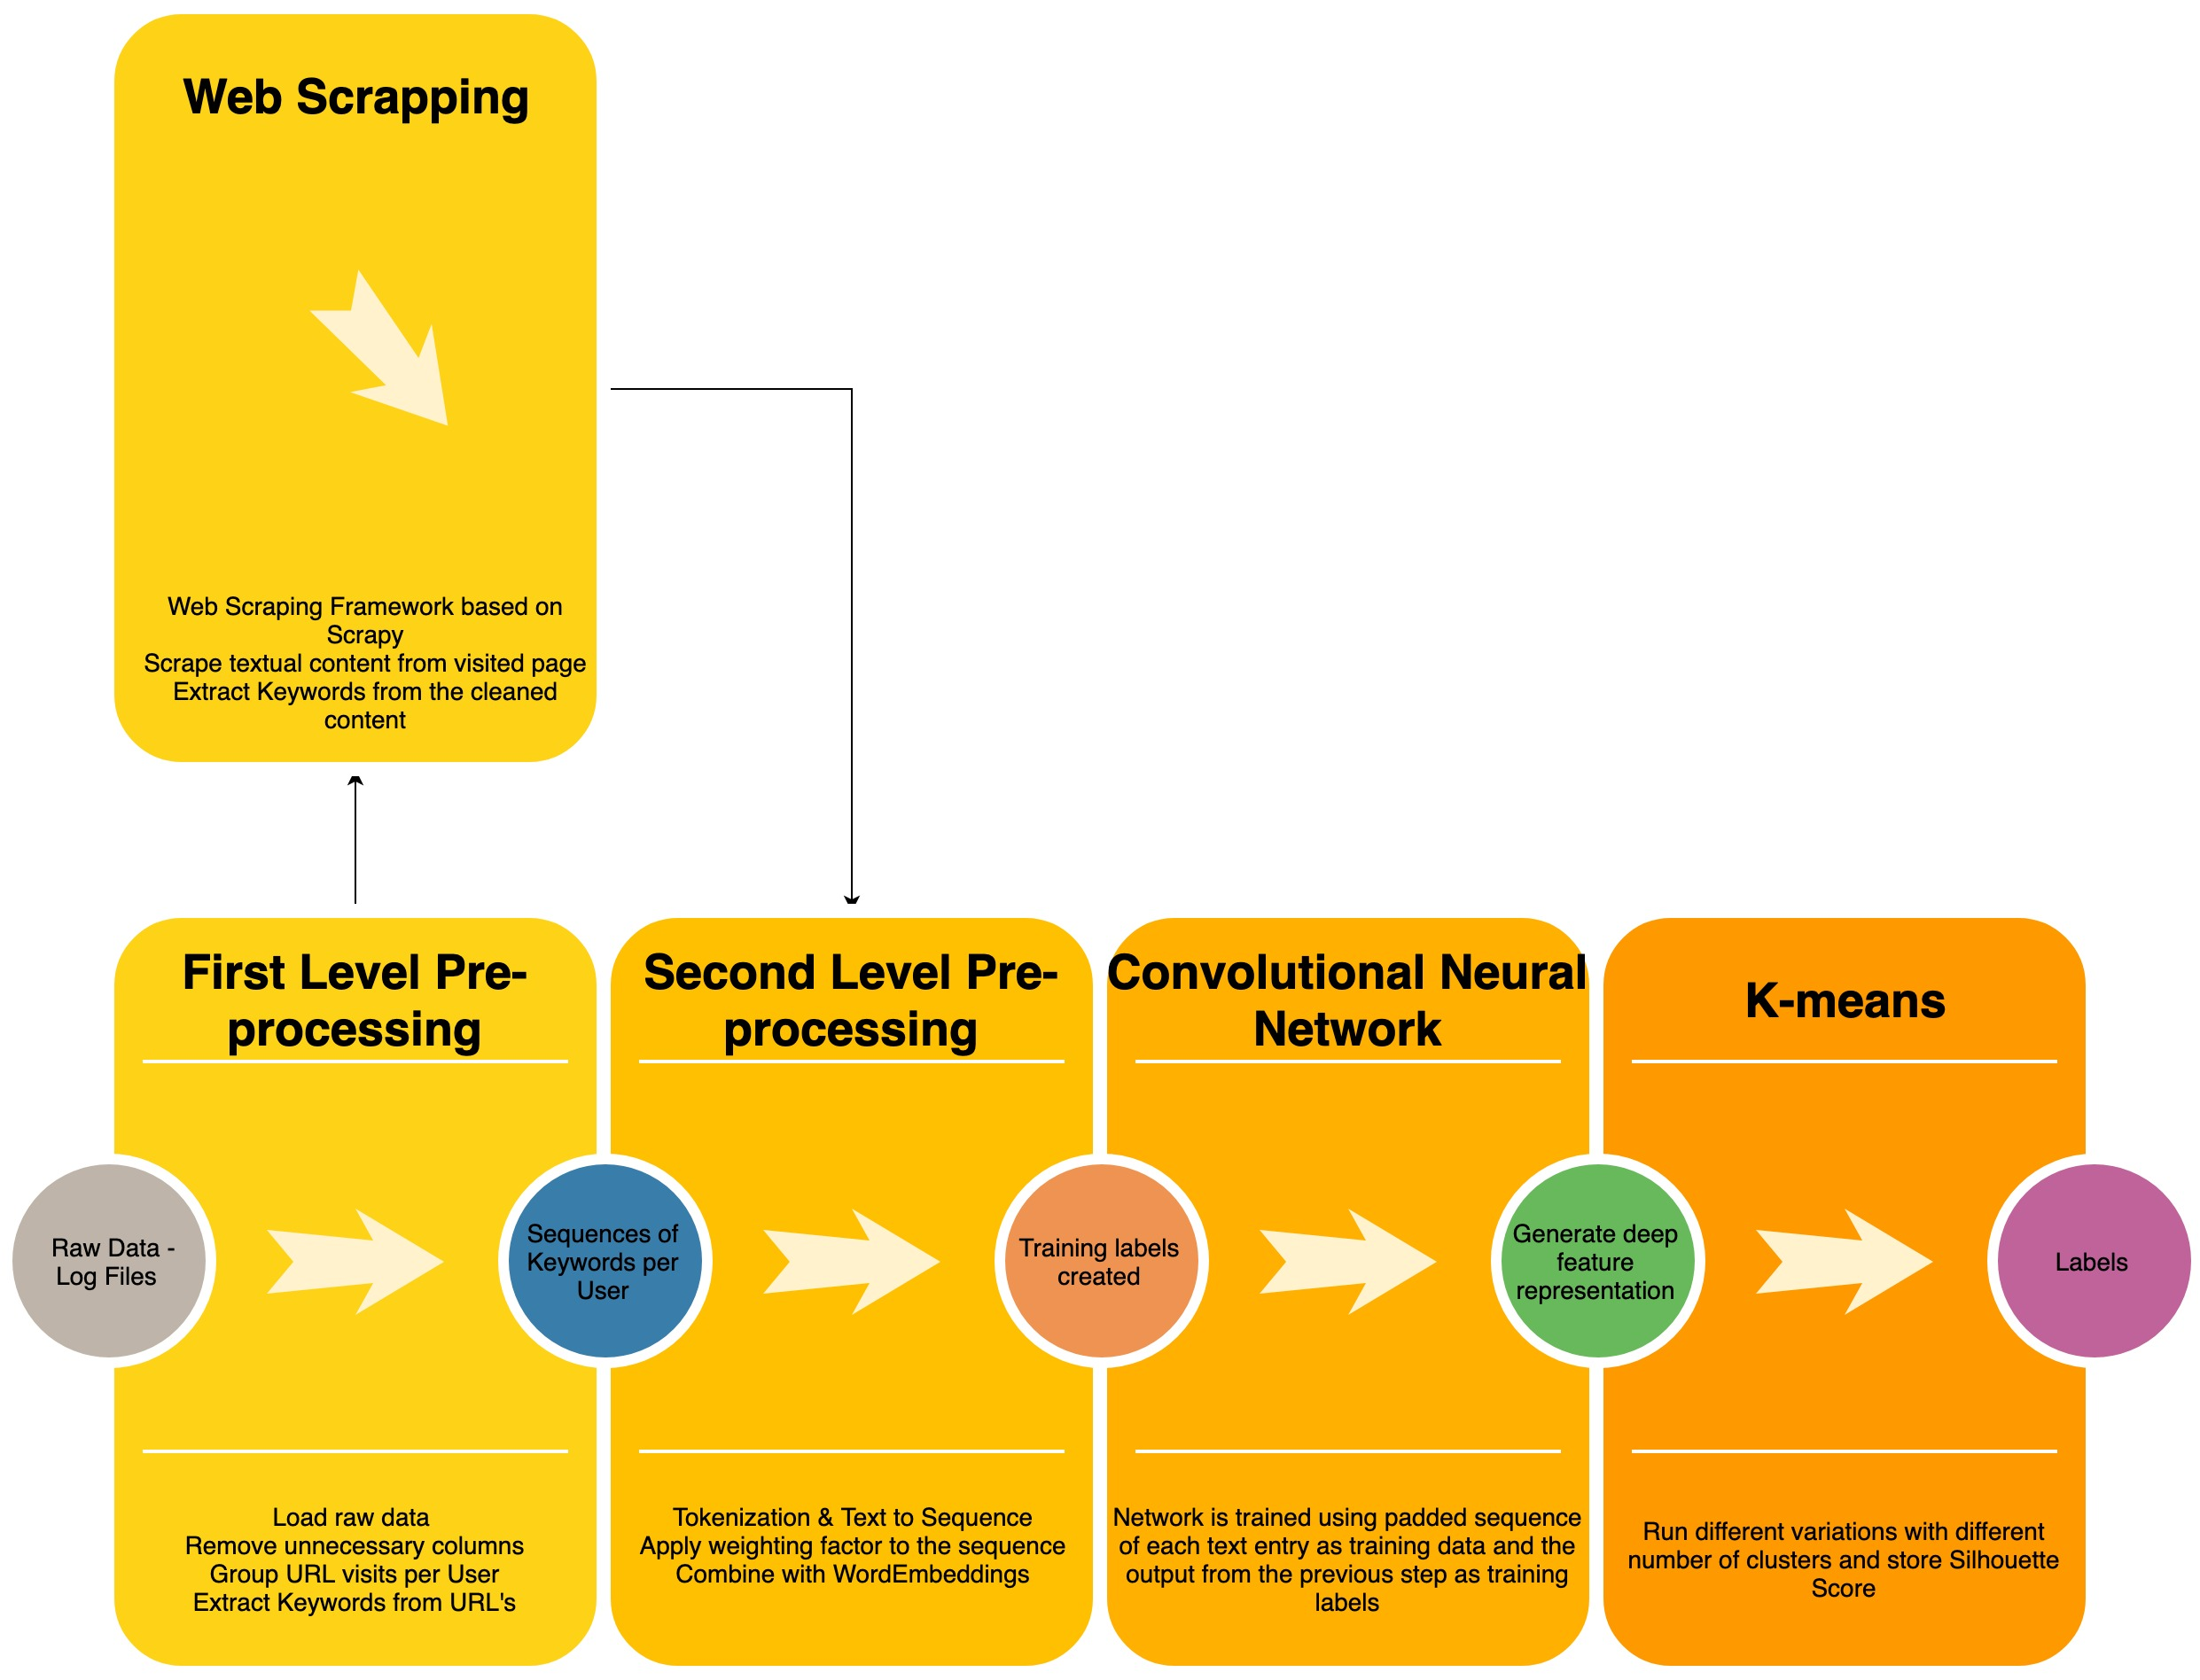

Our Approach High level

Slide 19
Our Approach High level – Main Flow
1. Read Raw Data
2. Filter data
3. Sort data frame
4. Identify transactions
5. Extraction of Keywords from URL
6. Remove unnecessary data
7. Standard Natural Language Processing (NLP) pipeline
8. Convolutional Neural Network
9. Cluster data
First-Level Processing
Second-Level Processing
Produce Deep Feature Representation
Output cluster labels and keywords per cluster
Notes:
Here you can see a really high level of it.
Raw data (log files) is loaded into MySQL DB - due to size
From there we loaded it, via queries, and clean it via python. We remove unneceseray data. The most important takeaways here are that we group user visits based on the Maximal Forward Reference Module - described more in the paper but in short. The visits are ordered based on time stamp -> and you have navigational and content pages.
Up until now the steps were similar to what have been done before with a few changes. The main change however has to do with the way we extract keywords
Here you can see an example url.
Ming-Syan Chen, Jong Soo Park, and P. S. Yu. 1996. Data mining for path traversal patterns in a web environment

Slide 20
Our Approach High level – Side Flow
1. Read Raw Data
2. Filter data
3. Sort data frame
4. Identify transactions
5. Scrape Textual Content from visited page
6. Clean Text
7. Extract Keywords from text
8. Standard Natural Language Processing (NLP) pipeline
9. Convolutional Neural Network
10. Cluster data
First-Level Processing
Enrich available data
Second-Level Processing
Produce Deep Feature Representation
Output cluster labels and keywords per cluster

Slide 21
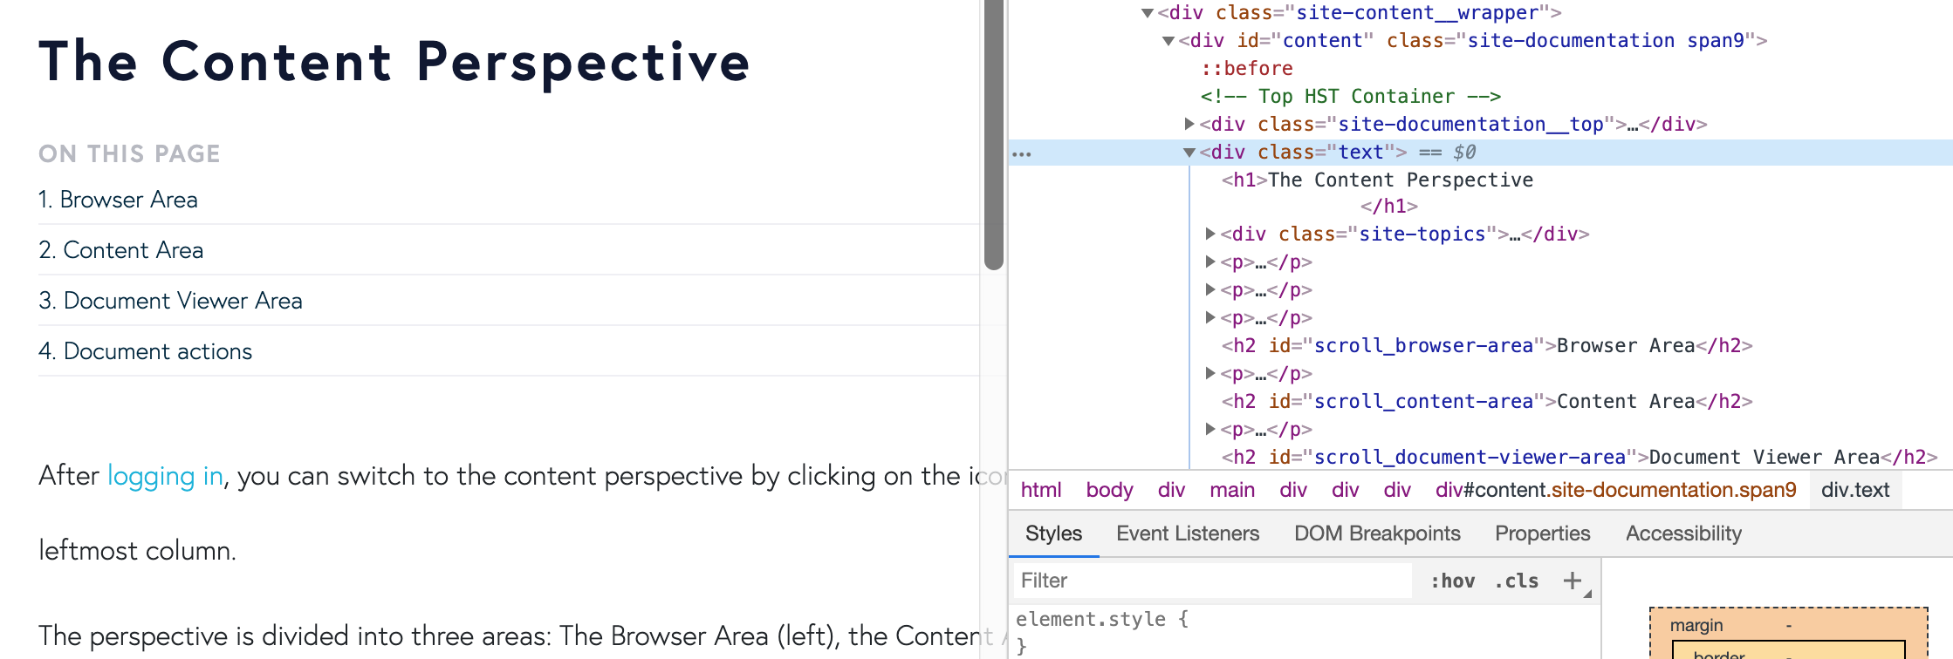

Web Scrapping Main Takeaways
Notes:
Why was this necessary? Nowadays the importance of the URL has slightly fallen behind. For example, in a google search the majority of people will look into the provided summary of the page, rather than the specific link itself, the content after the domain. According to this, we can formulate a hypothesis that the actual content will be more helpful when segmenting users, rather than the URL. To test the hypothesis, a framework was developed, capable of following a given URL and scraping the content.
Scrapy, which is a free and open-source web-crawling framework written in Python.
PageRank

Slide 22

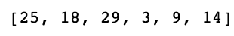

Second – Level Processing Main Takeaways
Tokenizer on either output of First level pre-processing or scrapped content
Text corpus is vectorized – each word is replaced by a number, based on its frequencies
Utilize Word Embeddings, made publicly available by Tomas Mikolov
Transform the sequence into matrix, with a weighting factor
Average embedding is generated based on the word embedding and the matrix – training labels
Input data - Keywords
Input to Sequence
Padded Sequence
Padded Sequence
Notes:
Second Level is basically the pre-processing we do before the feeding the data into the Neural Network.
It is made of standard NLP steps
(Input to Sequence) lower integer means more frequent word (often the first few are stop words because they appear a lot)
Padded Sequence, accounts for the length of the keywords/transactions

Slide 23
Second – Level Processing Main Takeaways
Tokenizer on either output of First level pre-processing or scrapped content
Text corpus is vectorized – each word is replaced by a number, based on its frequencies
Utilize Word Embeddings, made publicly available by Tomas Mikolov
Transform the sequence into matrix, with a weighting factor
Average embedding is generated based on the word embedding and the matrix – training labels
Input data - Keywords
Input to Sequence
Padded Sequence
Notes:
Second Level is basically the pre-processing we do before the feeding the data into the Neural Network.
It is made of standard NLP steps
(Input to Sequence) lower integer means more frequent word (often the first few are stop words because they appear a lot)
Padded Sequence, accounts for the length of the keywords/transactions

Slide 24
Convolutional Neural Network Main Takeaways
According to RQ2, we aimed at comparing our implementation with the reported one by Jiaming Xu et al. [2]
Based on this – we went for Convolutional Neural Networks
The model design is based on extensive literature review, where several things were considered:
Size of Filters
Overfitting
All hyperparameters – filter size, epochs, batch sizes etc. Were tuned for the local machine on which all testing and development was conducted.
Padded Sequence

Slide 25
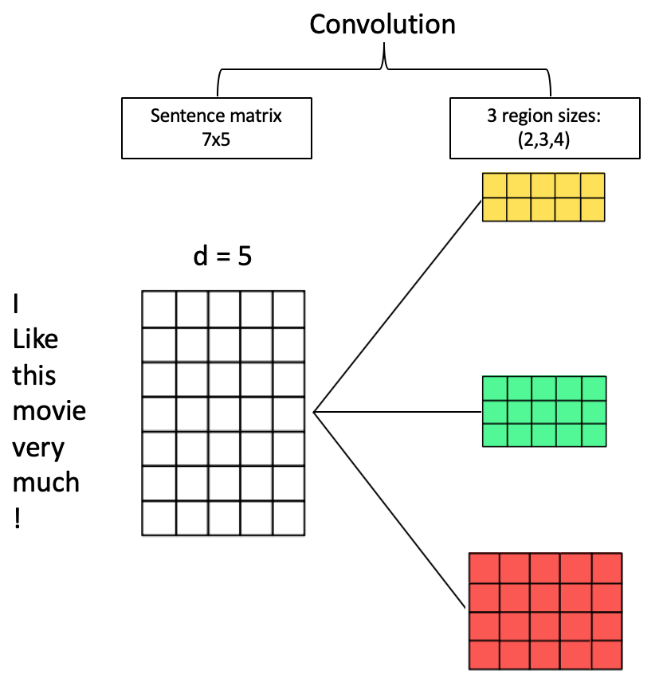
Convolutional Neural Network Main Takeaways
According to RQ2, we aimed at comparing our implementation with the reported one by Jiaming Xu et al. [2]
Based on this – we went for Convolutional Neural Networks
The model design is based on extensive literature review, where several things were considered:
Size of Filters
Overfitting
Padded Sequence

Slide 26
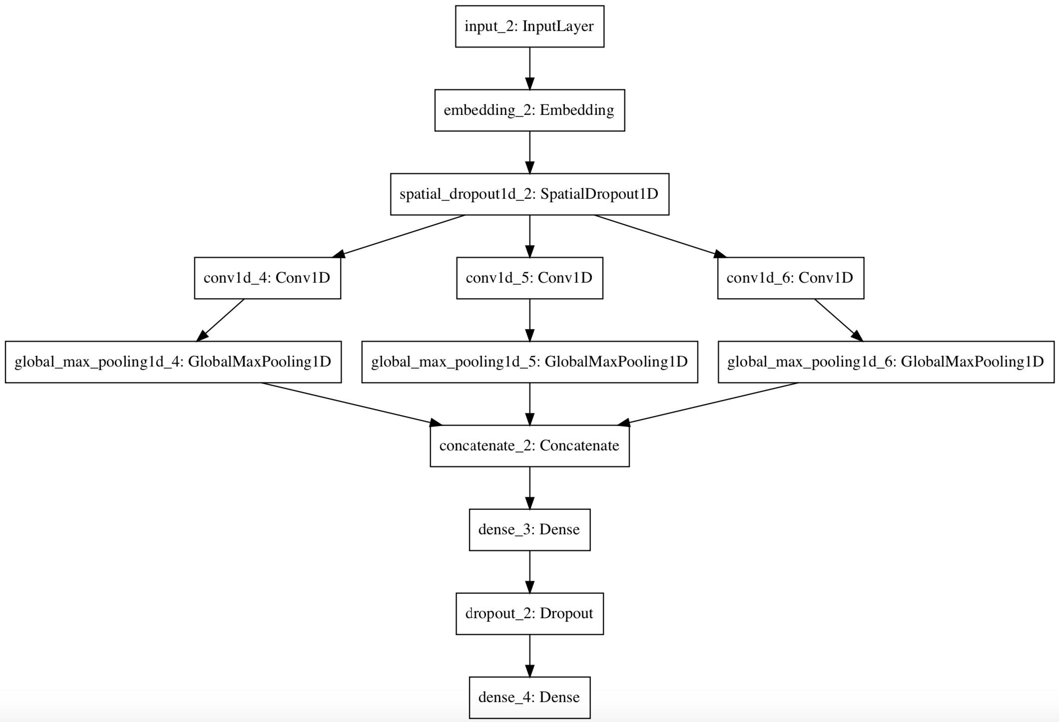
Convolutional Neural Network Design
Notes:
Size of filters: In the paper, the authors argue that in earlier studies of CNNs in NLP, researchers would rely on filters with fixed sized, however when using such fixed sizes, one is prompt to either loose information, when the size is too small, or have as Siwei Lai et al. poin
Overfitting: Following different discussions and sources, such as the work of Nitish Srivastava et al. [33] on Dropout as a way to prevent Neural Networks of over-fitting, we directly apply a Dropout layer
Pooling layer: For example, if the input of the max pooling layer is 0,1,2,2,5,1,20,1,2,2,5,1,2, global max pooling outputs 55, whereas ordinary max pooling layer with pool size equals to 3 outputs 2,2,5,5,52,2,5,5,5 (assuming stride=1). In some domains, such as natural language processing, it is common to use global max pooling. In some other domains, such as computer vision, it is common to use a max pooling that isn't global.

Slide 27
Our Approach High level

Slide 28
Agenda
Outline
Project Statement
Related Work
Our Approach
Research Questions
Results
Conclusion
Questions

Slide 29
Research Questions
RQ1: To what extent can the use of CNN outperform K-modes clustering in unsupervised user segmentation, based on keywords extracted from the online journey?

Slide 30
Sub-Questions
Part 1: CNN
RQ2: How is our implementation, of the work of Jiaming Xu et al. , performing compared to reported results by them?
Part 2: Available Data in-house
RQ3: How can we evaluate the performance and results with the data in-house?
RQ4: Does it make sense to scrape the visited page and use keywords based on the scraped content?
RQ5: To what extent is the use of scraped content affecting the cluster performance and structure?

Slide 31
Agenda
Outline
Project Statement
Related Work
Our Approach
Research Questions
Results
Conclusion
Questions

Slide 32
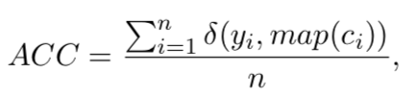
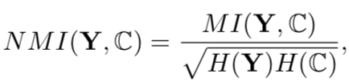
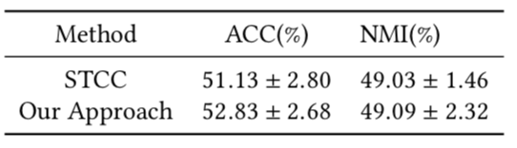
Results – Part 1 Model Comparison against results reported in [2]
Measurements:
Accuracy (ACC):
Normalized Mutual Information (NMI):
Results are based on the average of 5 model runs and 100 clusters. STCC scores are taken from [2]
Notes:
Self-Taught Convolutional Neural Net- works for Short Text Clustering (STCC)
Accuracy (ACC): The amount of correct prediction done by the model. In our case, we check the k-means labels against the ground truth.
n is the total number of texts, à x; y is the indicator function that equals one if x = y and e- quals zero otherwise, and map ci is the permutation mapping function that maps each cluster label ci to the equivalent label from the text data by Hungarian algorithm
Normalized Mutual Information (NMI): Measure describing the relatedness of two variables. It measures how much one of the variables is able to describe the other one. The end value is then normalized between 0 (no mutual information) and 1 (perfect correlation).
Normalized mutual information between tag/label set Y and cluster set C is a popular metric used for evaluating clustering tasks. Formula: M I (Y,C)is the mutual information between Y and C, (H·) is entropy and the denominator sqrt(H(Y)H (C)) is used for normalizing the mutual information to be in range of (0,1)

Slide 33
Results – Part 1 Model Comparison against results reported in [2]
Measurements:
Accuracy (ACC):
Normalized Mutual Information (NMI):
Results are based on the average of 5 model runs and 100 clusters. STCC scores are taken from [2]
Method | ACC (%) | NMI (%)
STCC | 51.13 ± 2.80 | 49.03 ± 1.46
Our Approach | 52.83 ± 2.68 | 49.09 ± 2.32
Notes:
Self-Taught Convolutional Neural Net- works for Short Text Clustering (STCC)
Accuracy (ACC): The amount of correct prediction done by the model. In our case, we check the k-means labels against the ground truth.
n is the total number of texts, à x; y is the indicator function that equals one if x = y and e- quals zero otherwise, and map ci is the permutation mapping function that maps each cluster label ci to the equivalent label from the text data by Hungarian algorithm
Normalized Mutual Information (NMI): Measure describing the relatedness of two variables. It measures how much one of the variables is able to describe the other one. The end value is then normalized between 0 (no mutual information) and 1 (perfect correlation).
Normalized mutual information between tag/label set Y and cluster set C is a popular metric used for evaluating clustering tasks. Formula: M I (Y,C)is the mutual information between Y and C, (H·) is entropy and the denominator sqrt(H(Y)H (C)) is used for normalizing the mutual information to be in range of (0,1)

Slide 34
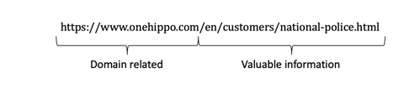
Results – Part 2 Comparison against results reported in the baseline model
Comparison of Keywords extraction approach
Better anticipation of numeric variables & URL related words
Automatically recognize the domain and focus on the important part
Customer, police, national
Notes:
We first did a comparison of the approaches for Keywords extraction
Main takeaways:
In the baseline they hardcoded the domains, where as we automatically recognize the domain
We were able to better deal with numeric values and other URL related words such as http or www
First point is that, compared to the baseline, where the domain variations are hard-coded, our approach automatically recognizes the domain and focuses only on the important part. However, comes at price of performance
In addition our approach performs better in cleaning numeric values, as well as URL related words, like ’http’ or ’www’.

Slide 35
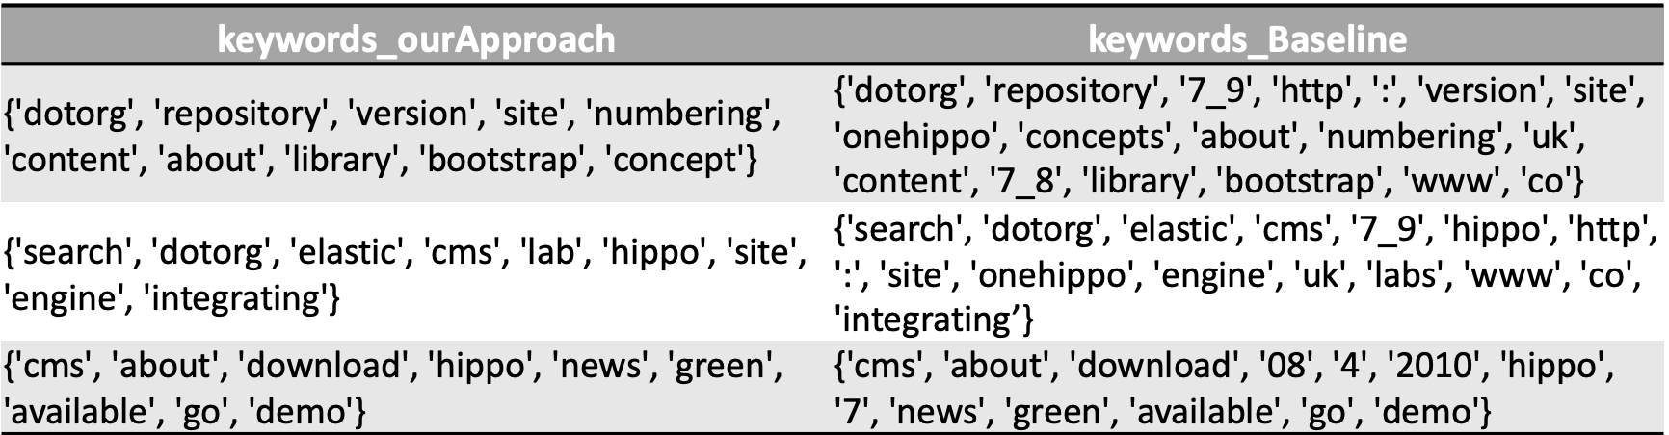
Example

Slide 36
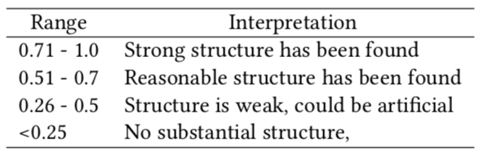
Results – Part 2 Approach Comparison against results reported in the baseline model
According to Rousseuw
Cluster Evaluation
Due to the lack of ground truth we used the Silhouette Score
Results are based on raw log files
10,000 rows
Containing VisitorID, TimeStamp, visitedURL
Notes:
As we do not have ground truth labels, for the evaluation of the clusters we used the Silhouette Coefficient, proposed by Rousseuw.
This coefficient aims at providing a graphical aid to the interpretation and validation of cluster analysis. The table below gives an overview of the interpretation of the different scores.
The silhouette value is a measure of how similar an object is to its own cluster (cohesion) compared to other clusters (separation).
It is based on a distance matrix such as Euclidian.

Slide 37
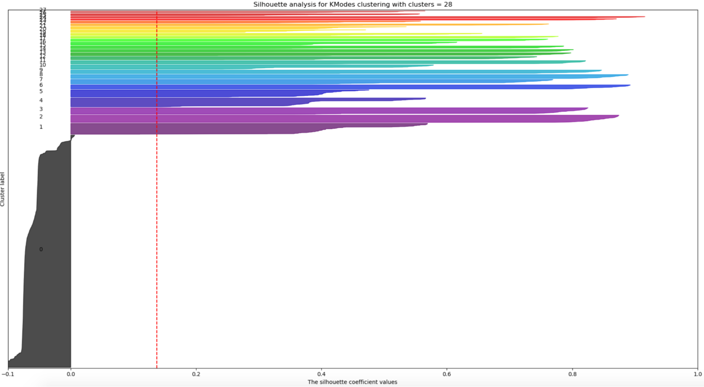
Baseline Results
With noise, taken from [1]
Notes:
The main takeaways from their results are:
(1) Cluster 0 contains noisy data, which cannot be clustered, thus should be used with caution.
(2) Leaving the noise aside, the remaining data holds a good structure. Good, is based on the score of the clusters and the interpretation from Table 5 and describes the fact that the data points are more related to the other points in the same clusters than data points from other clusters.
(3) In their work, before the noise removal, the average score (dotted line) went above 0.2 for 112 clusters, which shows that a high number of clusters is required in order to increase the average score. In general, the Silhouette Coefficient will increase with the increase in the number of clusters.
(4) With the removal of cluster 0, we observe an increase in the average score, based on the structure of the remaining clusters. From figure 8, we can see that roughly half of the clusters are below 0.6, which according to Table 5 might be considered as weak or artificial structure.

Slide 38
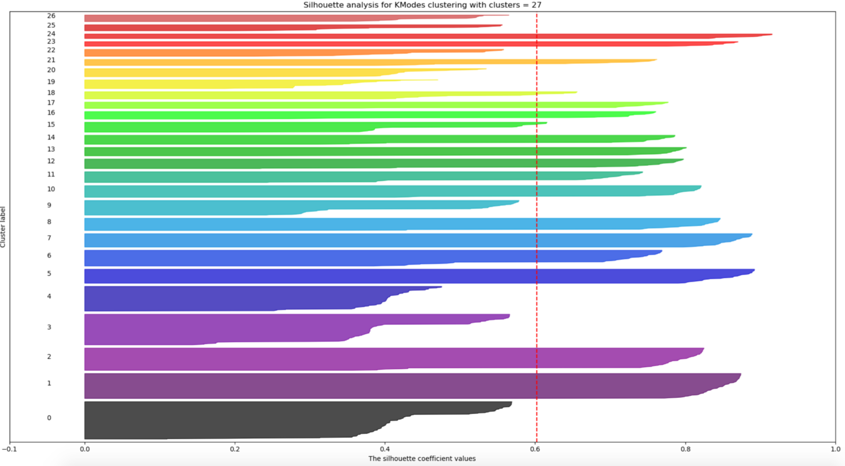
Baseline Results
Without Noise, taken from [1]

Slide 39
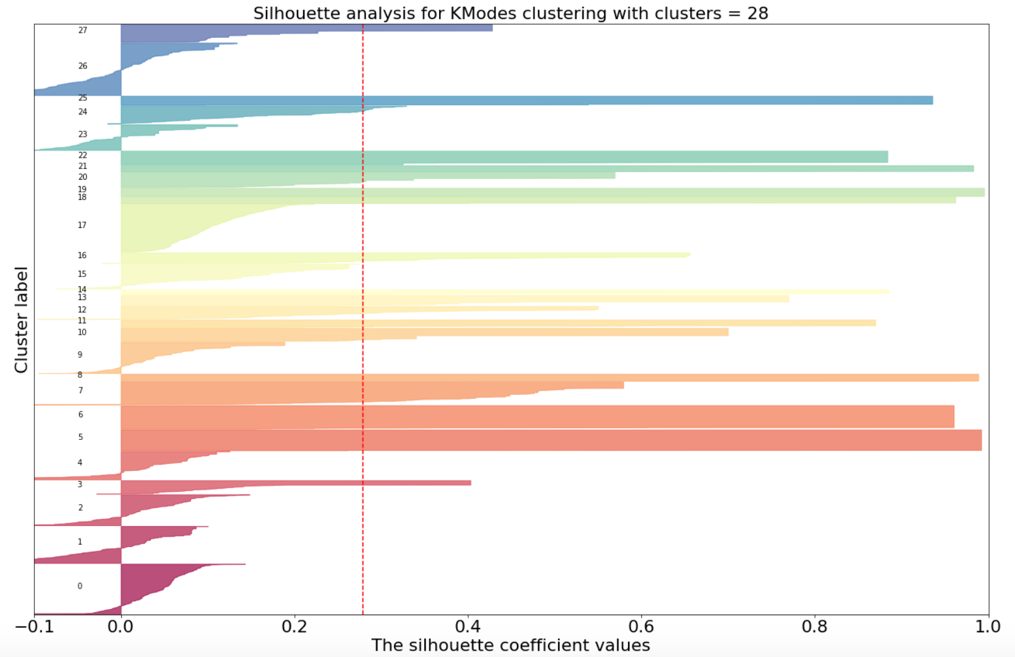
Our Approach – Keywords from URL
With Noise
Notes:
The main takeaways from our results are:
(1) In the baseline paper, they did not provide an overall plot showing the score per number of clusters, so we had to make our conclusion based on the provided plots, where the highest average score was with k = 112, a bit over 0.2. The average score is based on the structure of all clusters and based on this our ’noisy’ clustering is better than the reported one. Although we had a better average score, the lack of a single ’noise’ bucket resulted in noise within the clusters. This resulted in poor quality , score below 0.6, for less then half of our clusters.
(2) We did not have a single ’noise’ bucket, however by using the default parameters of DBSCAN we were able to clean the overall noise and then outperform their reported score. They, indeed, do not specify that this is the best possible score, however they do not report a higher one.
(3) Using scrapped data drastically increased the input shape for the Neural Network, however it was worth it as it showed better results.
(4) Taking it one step further we map the visitorId to a cluster together with the corresponding keywords for this cluster.

Slide 40
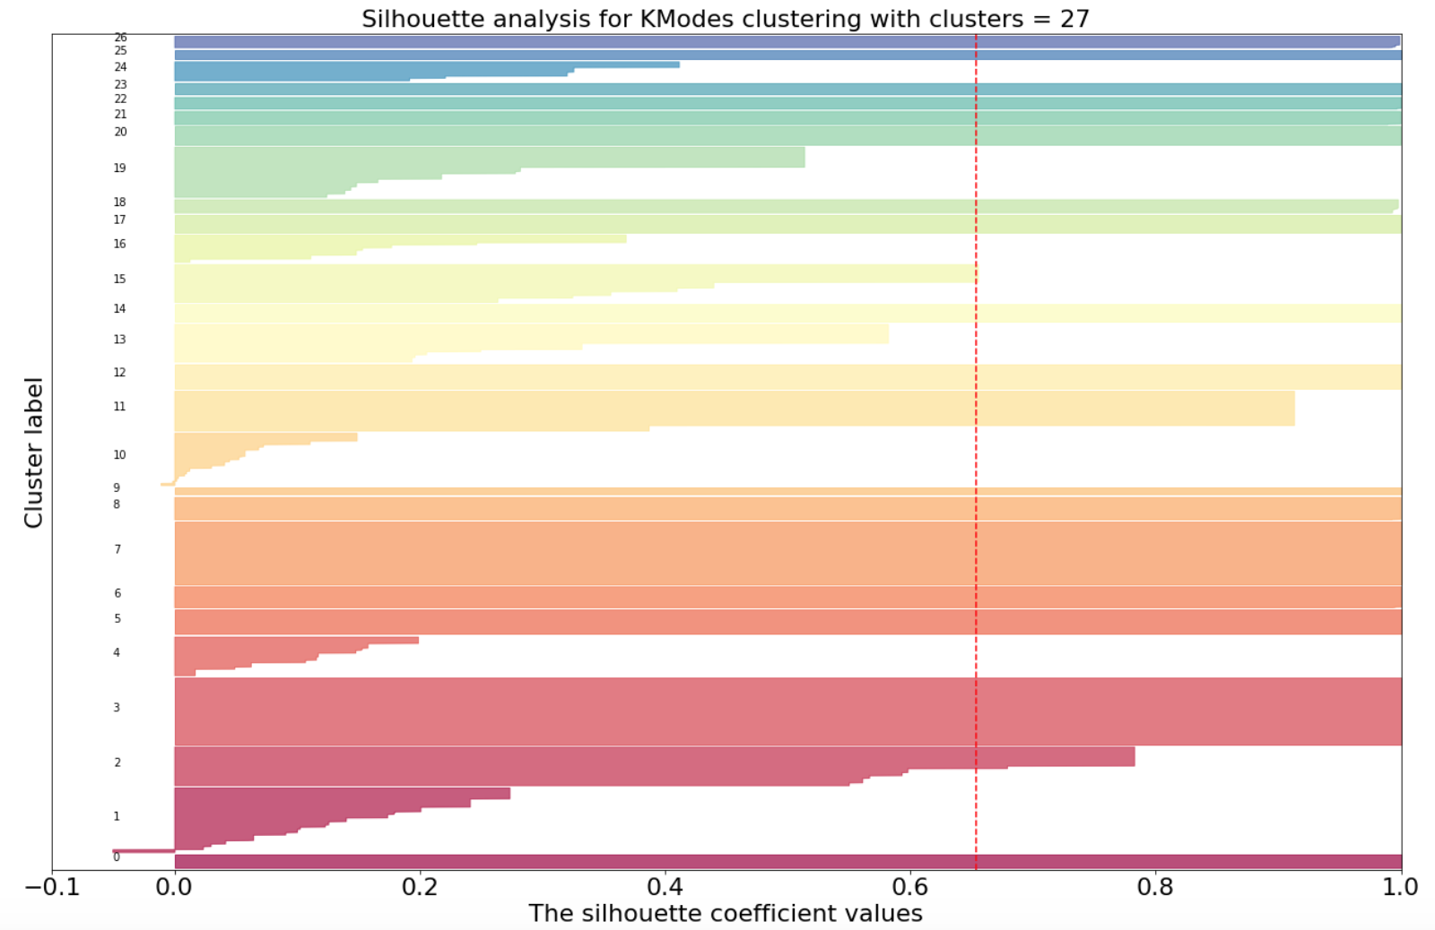
Our Approach – Keywords from URL
Without Noise

Slide 41
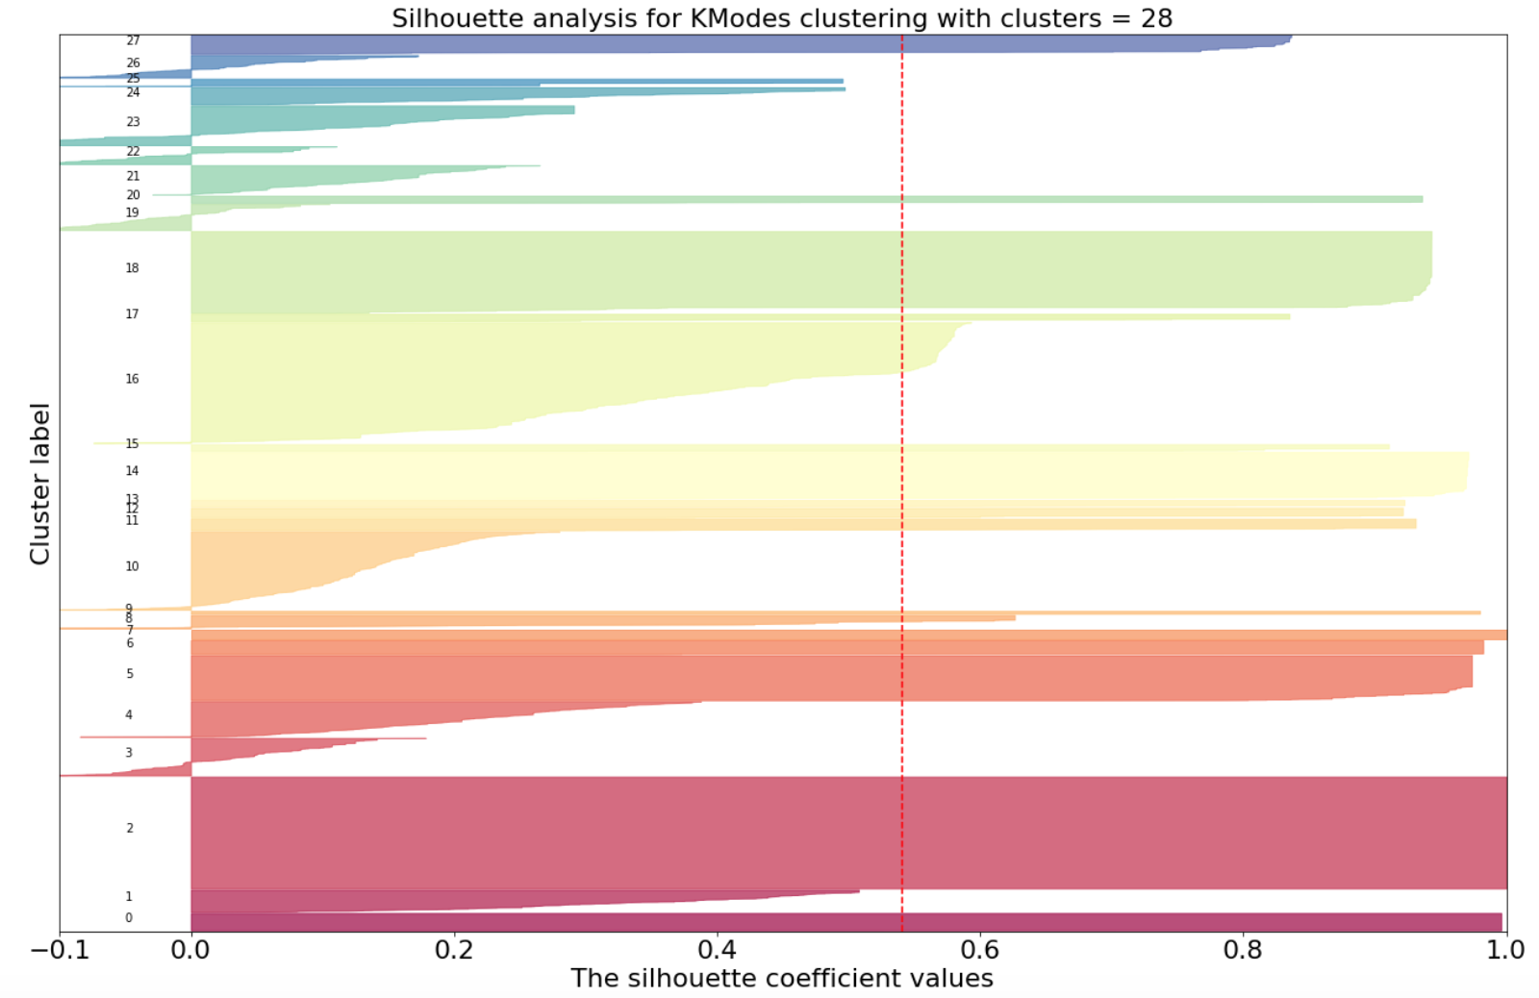
Our Approach – Keywords from Scrapped Content
With Noise
Notes:
The main takeaways from our results are:
(1) In the baseline paper, they did not provide an overall plot showing the score per number of clusters, so we had to make our conclusion based on the provided plots, where the highest average score was with k = 112, a bit over 0.2. The average score is based on the structure of all clusters and based on this our ’noisy’ clustering is better than the reported one. Although we had a better average score, the lack of a single ’noise’ bucket resulted in noise within the clusters. This resulted in poor quality , score below 0.6, for less then half of our clusters.
(2) We did not have a single ’noise’ bucket, however by using the default parameters of DBSCAN we were able to clean the overall noise and then outperform their reported score. They, indeed, do not specify that this is the best possible score, however they do not report a higher one.
(3) Using scrapped data drastically increased the input shape for the Neural Network, however it was worth it as it showed better results.
(4) TakingitonestepfurtherwemappedthevisitorIdtoacluster together with the corresponding keywords for this cluster.

Slide 42
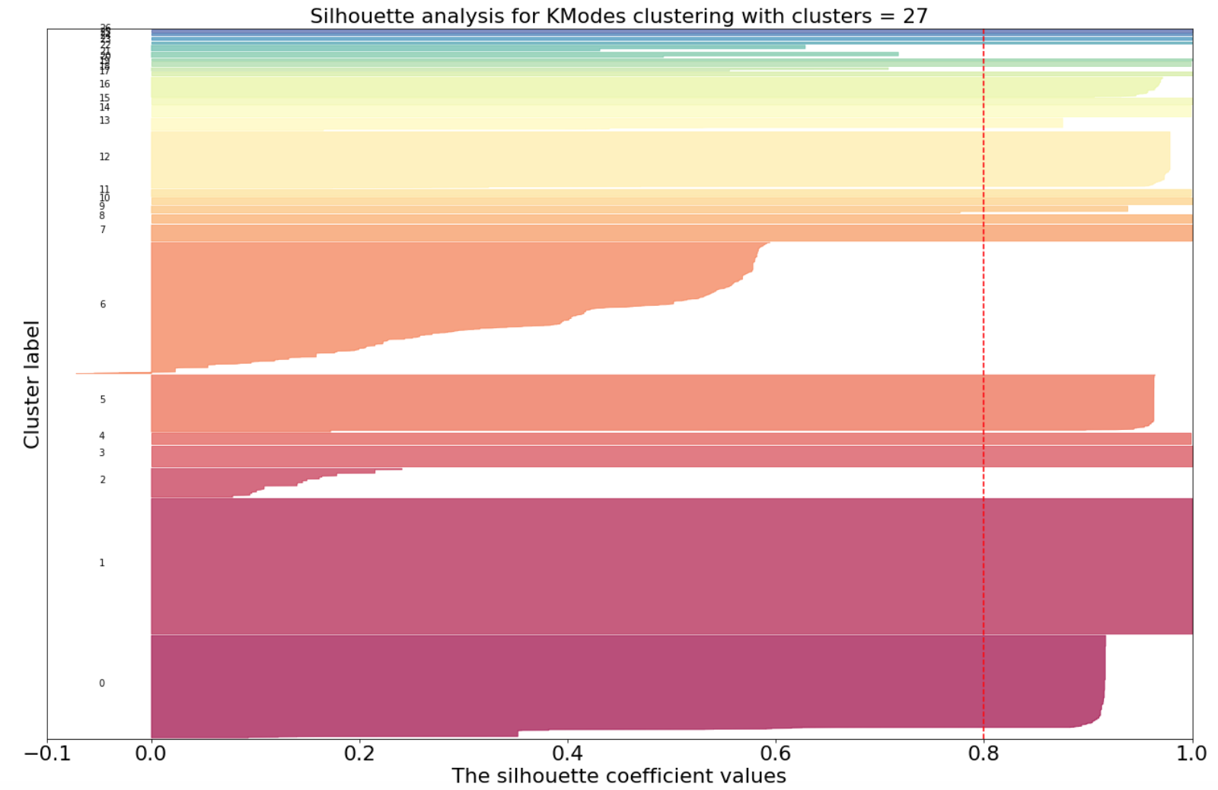
Our Approach – Keywords from Scrapped Content
Without Noise

Slide 43
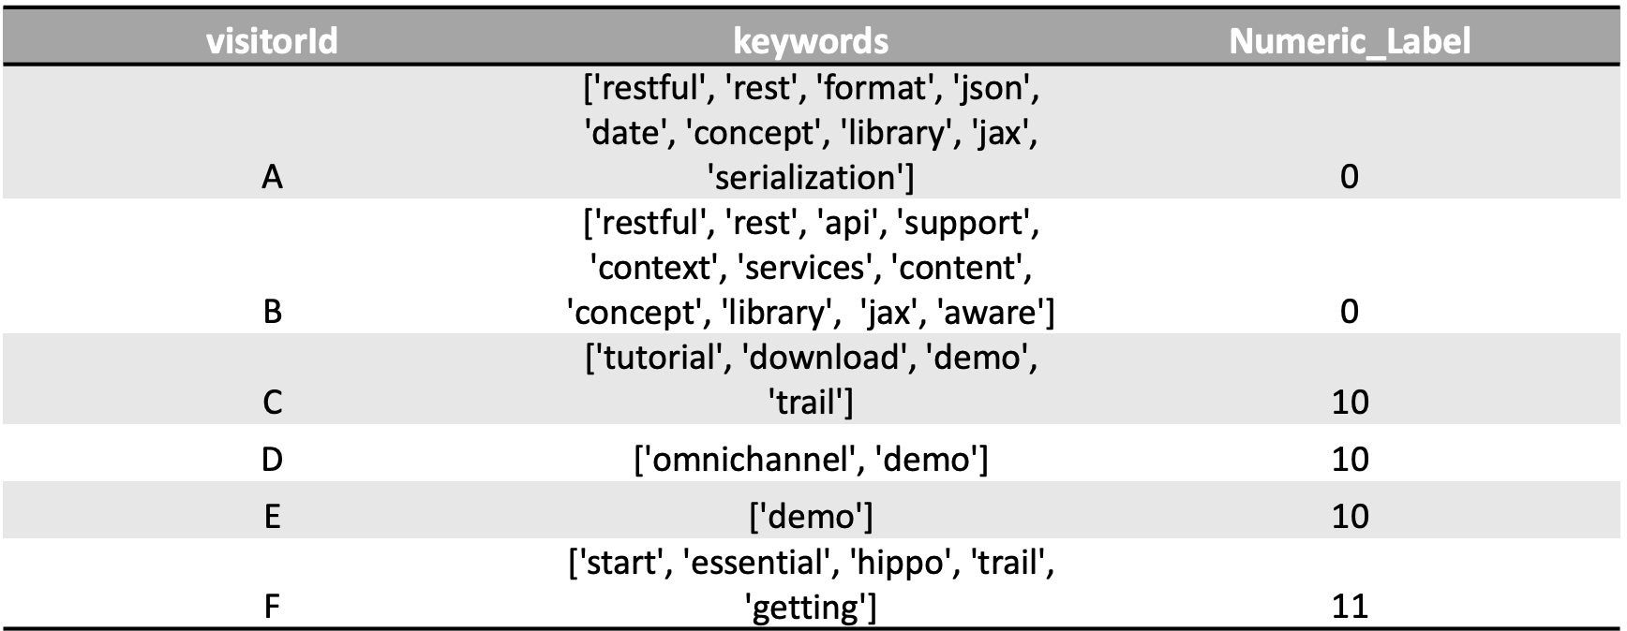
Containing cluster label and keywords for the given cluster
Final Output Example

Slide 44
Agenda
Outline
Project Statement
Related Work
Our Approach
Research Questions
Results
Conclusion
Questions

Slide 45
Conclusion
Learned features from Convolutional Neural Networks seemed to be more descriptive
According to the output introducing a new Keywords extraction function improved the quality of the words
We were able to achieve a slight improvement, compared to the results reported in [2]
Domain knowledge required to better formulate the clusters
Scraped content proved more descriptive.

Slide 46

Questions ?

Slide 47
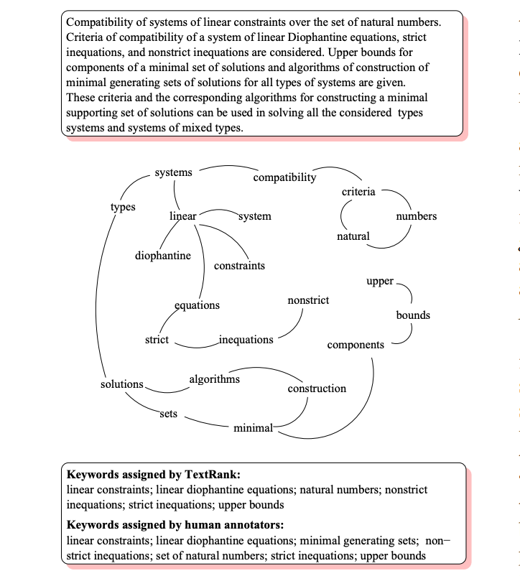
TextRank
First the text is tokenized, and annotated with part of speech tags – a preprocessing step required to enable the application of syntactic filters. To avoid excessive growth of the graph size by adding all possible combinations of sequences consisting of more than one lexical unit (ngrams), we consider only single words as candidates for addition to the graph, with multi-word keywords being eventually reconstructed in the post-processing phase. Next, all lexical units that pass the syntactic filter are added to the graph, and an edge is added between those lexical units that co-occur within a window of words. After the graph is constructed (undirected unweighted graph), the score associated with each vertex is set to an initial value of 1, and the ranking algorithm described in section 2 is run on the graph for several iterations until it converges – usually for 20-30 iterations, at a threshold of 0.0001.
Section 2 - the score associated with a vertex is determined based on the votes that are cast for it, and the score of the vertices casting these votes.
During post-processing, all lexical units selected as potential keywords by the TextRank algorithm are marked in the text, and sequences of adjacent keywords are collapsed into a multi-word keyword. For instance, in the text Matlab code for plotting ambiguity functions, if both Matlab and code are selected as potential keywords by TextRank, since they are adjacent, they are collapsed into one single keyword Matlab code.
Notes:
http://web.eecs.umich.edu/~mihalcea/papers/mihalcea.emnlp04.pdf

